Slide 1
3D-Jury: A Simple Approach to Improve Protein Structure Predictions
Krzysztof Ginalski, Arne Elofsson,
Daniel Fischer and Leszek Rychlewski
Bioinformatics, Vol. 19, No.8, pp. 1015–1018, 2003
Presenter: Shiuan-Wen Chen
Date: Nov. 30, 2006

Slide 2
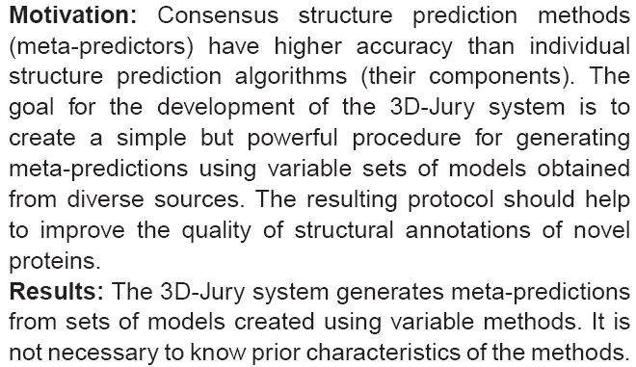
ABSTRACT

Slide 3
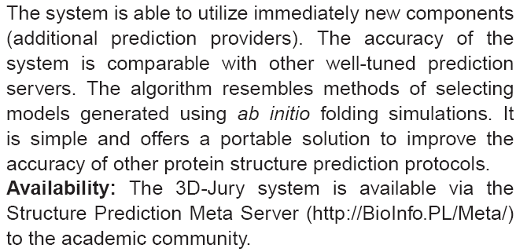
ABSTRACT

Slide 4
INTRODUCTION
Objective and community-wide assessment of the accuracy of available methods such as CASP (Moult et al., 2001) or CAFASP (Fischer et al., 2001) have made a significant contribution to the progress in this area.
Due to the increased number of available predictions, the chances of obtaining a correct model increases.
From the user point of view, it is not easy to benefit from the large selection and it is sometimes even more difficult to select the best model.

Slide 5
SYSTEM AND METHODS
First attempts to benefit from the variety of available services were made by the semi-automated CAFASP-Consensus groups (Fischer et al., 2001).
First benchmarks within the LiveBench-2 (Bujnicki et al., 2001) and LiveBench-4 experiments have indicated that fully automated meta-predictors are more accurate than any individual server used for building the consensus.
Initial results were obtained with the Pcons (Lundstrom et al., 2001) method.

Slide 6
SYSTEM AND METHODS
The 3D-SHOTGUN meta-predictors (Fischer , 2002) are reminiscent of the so-called ‘cooperative algorithms’ known in the Computer Vision sub-area of Artificial Intelligence (Marr, 1982).
The program also takes as input the models with their confidence scores. The result is a hybrid model, which is spliced from fragments of the input models and has the potential of covering more parts of the native protein than any template structure alone.

Slide 7
SYSTEM AND METHODS
The 3D-Jury system, like other meta-predictors, incorporates the comparison of models as the main processing step.
The experience with ab initio prediction methods lead to the conclusion that averages of low-energy conformations obtained most frequently by folding simulations are closer to the native structure than the conformation with lowest energy.

Slide 8
SYSTEM AND METHODS
The direct translation of this finding into the field of fold recognition by threading methods would mean that most abundant high-scoring models are closer to the native structure than the model with highest score. This is the main rationale behind the 3D-Jury approach.

Slide 9
ALGORITHM
3D-Jury, takes as input groups of models generated by a set of servers, however, neglecting the assigned confidence scores.
All models are compared with each other and a similarity score is assigned to each pair, which equals to the number of C_{alpha} atom pairs that are within 3.5 Å after optimal superposition.
If this number is below 40, the pair of models is annotated as not similar and the score is set to Zero.

Slide 10
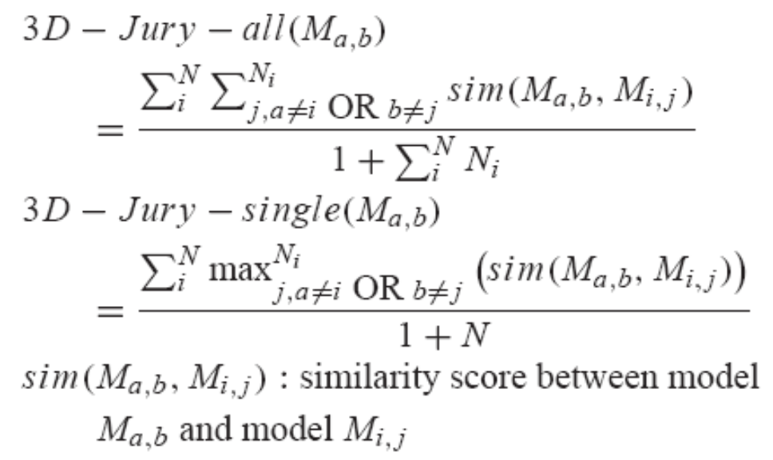
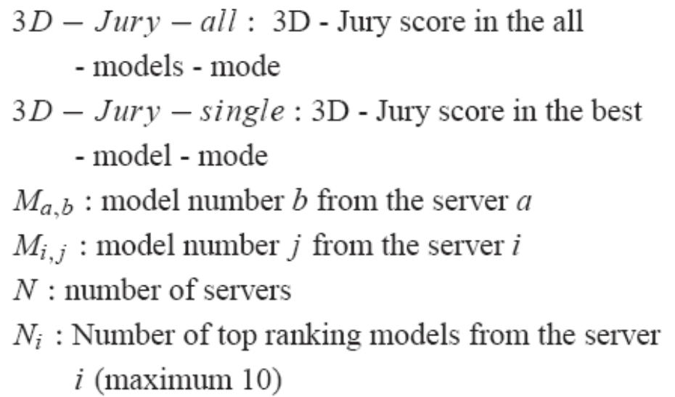
ALGORITHM
Ex: Server A Server B Server C
N=3
Model 1
Model 2
Model 1
Model 2
Model 3
Model 4
Model 1
Model 2
Model 3

Slide 11
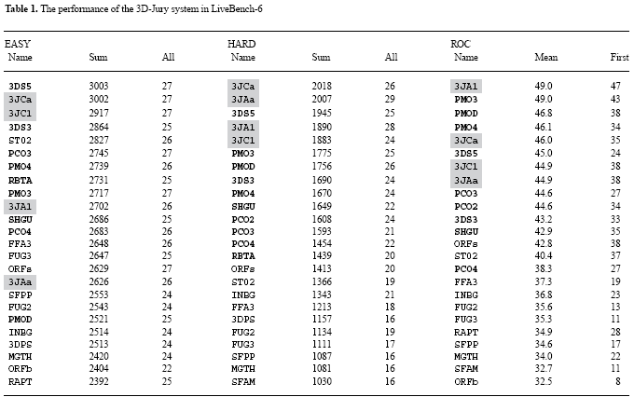
IMPLEMENTATION

Slide 12
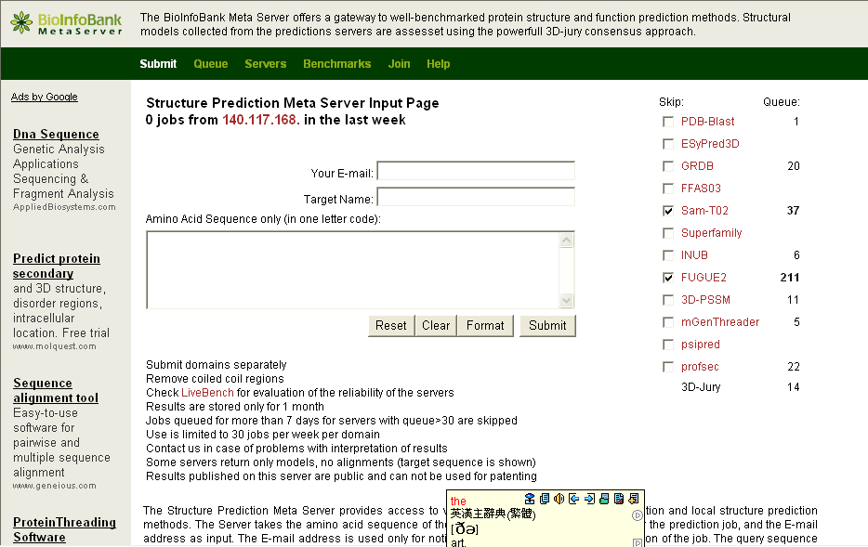
IMPLEMENTATION
The best results are obtained with the 3D-Jury system operating in the best-model-mode on a set of eight servers (ORFeus Pas et al., 2003; SamT02, Karplus et al., 2001; FFAS03, Rychlewski et al., 2000; mGenTHREADER, Jones, 1999; INBGU, Fischer, 2000; RAPTOR, Xu et al., 2003; FUGUE-2, Shi et al., 2001; 3D-PSSM, Kelley et al., 2000).
http://BioInfo.PL/Meta/

